Slide 1
Operating systems
Memory Management

Slide 2
Content Lecture#11
01
Memory Management
02
Address Binding
03
Segmentation
04
Paging
05
Address Translation

Slide 3

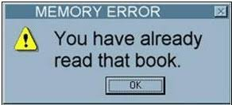
Lets take a Break
A programmer had a problem, so he used threds. Then he had two problems.

Slide 4
Memory
A
Address binding
is the mapping of the processor view of memory to the physical memory locations Typically occurs at one of three stages

Slide 5
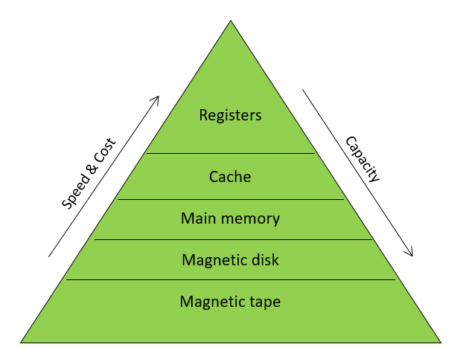
Memory
Memory
Memory hierarchy
Process loading and swapping
Memory management
Memory allocation methods
Storage management strategies
Contiguous memory allocation
Non contiguous memory allocation
Segmentation
Simple segmentation
Segment addressing
Paging
Simple paging
Implementation of paging
Used for storage and retrieval of data and instructions
Essential component
Logically memory system can be divided into three groups
Internal memory
Set of registers in processor
they hold temporary results during execution
Main memory
Communicates directly with CPU
Secondary (external memory)
Peripherals storage devices i.e disk & tape etc
Memory performance largely depends upon
The organization of memory
Storage capacity
Speed of memory system

Slide 6
Memory Hierarchy
Registers
are fastest, smallest and most expensive
Main memory
It is principal memory
It is generally extended with a higher speed smaller cache
Used to improve movement of data between main memory and processor registers
Usually not visible to user or programmer or indeed to the processor
External devices are permanent storage
Also referred as secondary or auxiliary memory
e.g. magnetic disk, tape, hard disk
The fastest memory is closest to CPU and slowest is away
The access time and approximate capacity for each memory is;
Name Access Time Capacity
Register 2-3 ns <1KB
Cache 3-5 ns 4-6MB
Main memory 7-10 ns 2GB – 32GB
Disk 100 ms 500GB – 6TB
Suppose processor request a word
If it is in level-1 cache, processor accesses it directly
If it is in level-2 cache the word is transferred to level-1 then to processer
Similarly data can be transferred from lower levels

Slide 7
Process Loading & Swapping
Process loading
Transfer of a process from secondary storage to main memory
Process Swapping
Transfer of a process from memory to secondary storage

Slide 8
Memory Management
Memory is a volatile array of words or bytes, shared by the CPU and I/O devices
Programs must be brought into memory and place in form of a process to be executed
The operating system manages the memory activities
Keep track of which parts of memory are currently being used and by whom
Decides which process(s) to load when memory space becomes available
Allocate and de-allocate memory space to processes as required In a uni-programming environment, main memory is divided into two parts
for operating system
for the user programs currently being executed
In a multiprogramming environment, the user part is further subdivided into sub-parts to accommodate several processes
The task of sub division of memory to pack as many processes is carried out dynamically by the memory manager and is called memory management
Memory manger is part of operating system

Slide 9
Memory Manager Duties &Problem
Duties
Execute maximum processes at the same time
Provide satisfactory level of performance
Sharing of memory space between processes
Protect each process from other
Transparent address of memory space for programmers
Problems which can arise at programmer’s level
Insufficient main memory available; for a program plus its data
The programmer must engage in a practice known as overlaying
Keep in memory only those instructions and data that are needed at any given time
Needed when process is larger than amount of memory allocated to it
In this program and data are organized in various modules which can be assigned the same region of memory, with a main program responsible for switching modules in and out as need
In a multiprogramming environment, programmer does not know how much space will be available or where the space will be

Slide 10
Address Binding
Address binding is the mapping of the processor view of memory to the physical memory locations
Typically occurs at one of three stages
Compile time
If memory location is known priori, absolute code can be generated
Must recompile code if starting location changes
Load time
Must generate re-locatable code if memory location is not known at compile time
Execution time
Binding delayed until run time if process can be moved during its execution from one memory segment to another
Need hardware support for address mapping

Slide 11
Logical vs. Physical Address Space
Logical VS Physical
Logical address
Generated by CPU
Also referred to as virtual address
Physical address
Address seen by the memory unit
Compile and load time binding
Logical = physical memory
Execution time binding
Logical is virtual memory, i.e. does not necessarily coincide with physical memory
Virtual Addresses
There exist a set of memory addresses that programs can produce
These program generated addresses are called virtual or logical addresses and form virtual address space
Physical addresses are the addresses seen by the memory unit
Logical and physical addresses are same at compile time
Logical and physical addresses differ in execution time

Slide 12
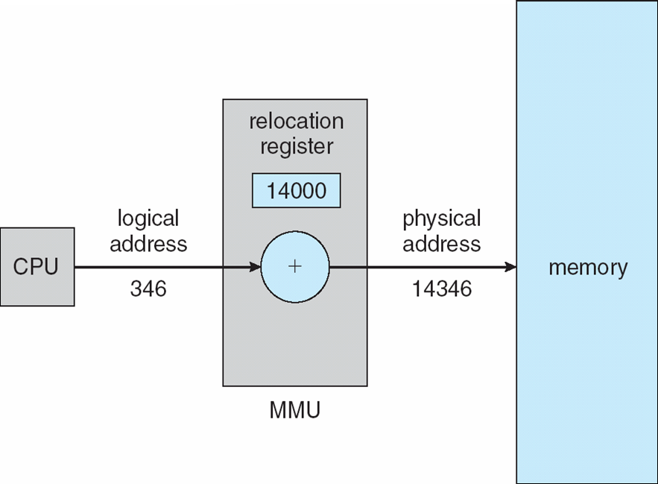
Memory Management Unit
Hardware device that maps virtual address to physical address
Use a base or relocation register
The value in relocation register is added to every address generated by a user process at the time it is sent to memory
The user programs deals with logical addresses
It never sees the real physical addresses
On computers without virtual memory, the virtual addresses are put directly onto memory bus
When virtual memory is used, the virtual addresses do not go directly to memory bus
Instead they go to memory management unit (MMU)
MMU is a chip or collection of chips that converts the virtual addresses onto the physical memory addresses
The user program deals with logical addresses
it never sees the real physical addresses

Slide 13
Memory Management Requirements
Relocation
Main memory is shared between processes
Swap active processes in and out to provide large pool of ready processes
Quite difficult to declare when swapped out process will be placed back
A process image occupies a contiguous region of main memory
To run this process, the processor hardware and operating system must be able to translate the memory reference found in code, into physical memory address
2. Sharing
Allow several processes to access the same area of main memory
Processes that are cooperating on some tasks may need to share access the same data structure
Allow controlled access to share areas of main memory without compromising essential protection

Slide 14
Memory Management Requirements
3. Protection
Each process must be protected by unwanted interference by other processes
Without prior permission, a process should not refer to other process
All memory references generated by a process must be checked at run time
to ensure that they refer only to the allocated memory space
The processor must abort such instructions when executed
Thus the memory protection requirement must be satisfied by the processor (hardware) rather than operating system
Since OS cannot anticipate all the memory references a program will make
Even if such participations are possible, it would be prohibitively time consuming to screen each program in advance for possible memory reference violation
A pair of base and limit registers define the logical address space
CPU must check every memory access generated in user mode to be sure it is between base and limit for that user

Slide 15
Memory Management Requirements
4. Local organization
Main memory is organized as a linear or one dimensional, address space that consist of a sequence of bytes or words
Secondary memory at its physical level is similarly organized
It does not correspond to the way programs are constructed
Mostly programs are organized into modules
Some of which are un-modifiable (read or executable only)
Some of which contain that can be modified
5. Physical organization
Secondary memory of large capacity provides long term storage of program and data
While a smaller main memory holds programs and data currently in use
The organization of flow of information between main memory and secondary memory is a major system concern

Slide 16
Program Loading into Memory
The core task of any memory management system is to bring and manage programs in main memory
In almost all modern multiprogramming systems, this task involves sophisticated scheme known as virtual memory
Virtual memory is in turn based on the use of one or both of two basic techniques
Segmentation
Paging

Slide 17
Memory Management Techniques
Different schemes used in operating systems to allocate memory to processes
Contiguous Memory Allocation
Single process system
Fixed size (static) partition memory
Variable sized (dynamic) partition memory
Segmentation
Non Contiguous Memory Allocation
Paging
Paged segmentation
Demand paging
Demand segmentation
Virtual memory

Slide 18
Single Process System
Memory is divided into two partitions
One for user process and
One for the operating system
Most common to place the operating system in low memory
Run one process at a time in high memory
Memory management is very simple
Example;
MS-DOS system is an example of this system
Unused
User
process
Operating
system

Slide 19
Fixed Sized Partition Memory
Process C
300 K
Partition 3 = 400 K
Partition 2 = 300 K
Partition 1 = 200 K
600 K
Process B
200 K
300 K
Process A
150 K
100 K
Operating System
0 K

Slide 20
Variable-Sized Partition Memory
The processes would be given as much storage as they required
Processes are loaded into consecutive areas until the memory is filled
When a partition is free another process is loaded into free partition
External fragmentation
It refers to the distribution of the free memory space, out-with any process allocation
What are the problems here?
What if the size of the vacant partition(s) is smaller than the size of the incoming process?
A new process cannot be started
Solution
Coalescing
It refers to combine two or more adjacent holes to accommodate a large incoming process
Difficulty: Coalescing is a time consuming procedure
Variable partition scheme has been used successfully in many computers
Overheads
In variable partition, the system must keep track of
the position
size of each hole
taking account of the effect of coalescing
The solution is to use linked list, which contains
Pointer to the start of each hole and
The hole size

Slide 21
Variable-Sized Partition Memory
Variable-sized partition with compaction
Compaction is a process of physically moving memory resident processes to close up the holes
Difficulty;
It is a time consuming procedure
All processes are suspended while reshuffling takes place
Not feasible in time critical system
Compaction may be performed
As soon as any process terminates
When new process cannot load due to fragmentation
At fixed intervals
When the user decide to do

Slide 22
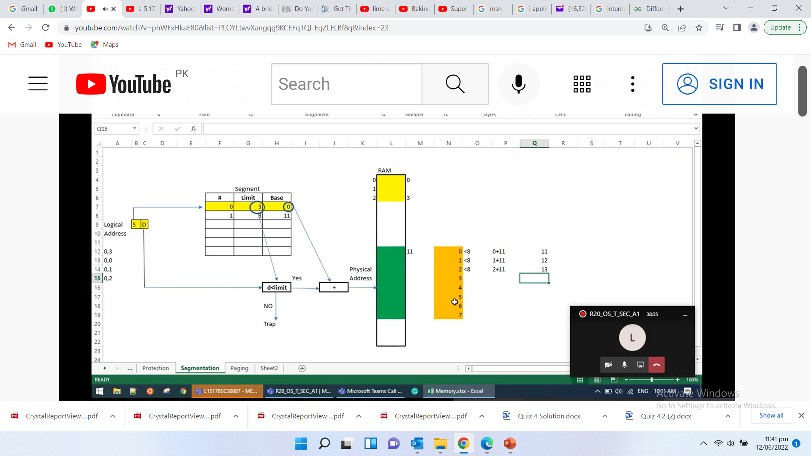
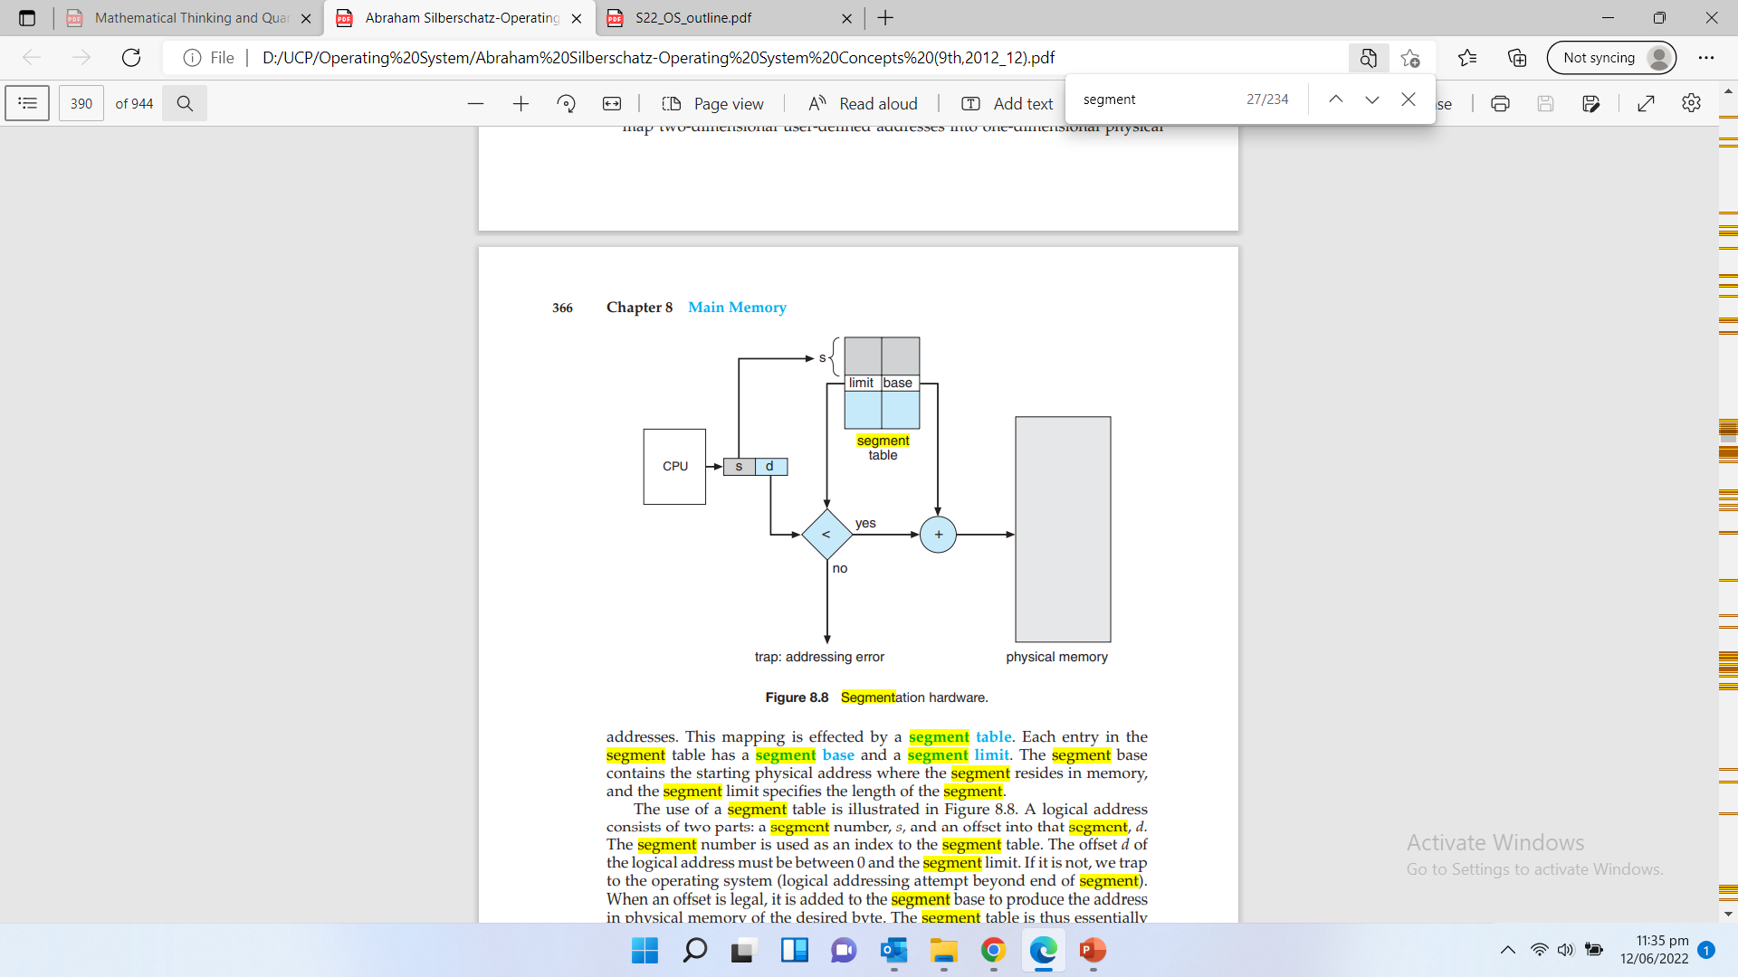
Segmentation
Logical Add
D+Base

Slide 23
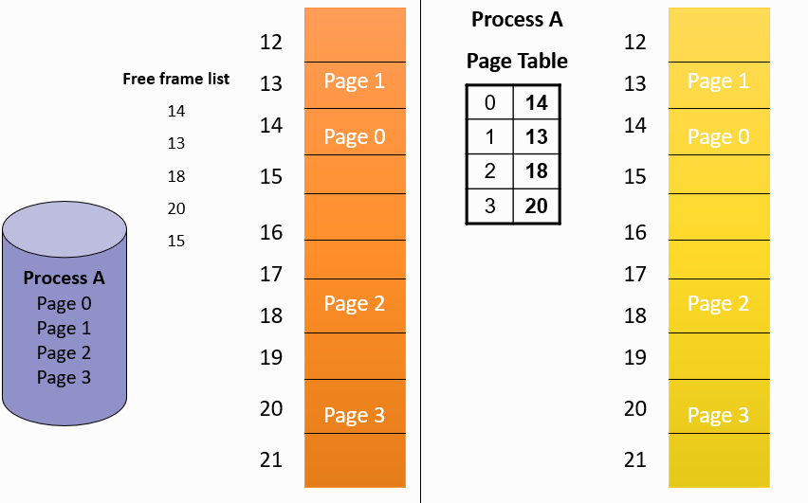
Paging
Fixed sized and variable sized partitions are insufficient due to
Internal fragmentation
External fragmentation
Paging removes these problems
Main memory is partitioned into equal fixed-size chunks called frames
Relatively small in size
Each process is also divided into fixed size chunks called pages
Same size as memory frames
Page size is typically power of 2 (typically 4K-8K)
depending on the computer architecture
No need of contiguous frames for a process or even in correct order

Slide 24
Page Addressing
In paging, a memory address locations has the form (p,d)
Where p is number of the page
d is the displacement (or offset) of the location from the start of the page
These parameters are derived from the actual memory address
Consider an example of 16-bit address;
p - page no. has the value range 0 to 31 (2⁵-1) or 32 pages
d – displacement value range 0 – 2047 i.e. (2¹¹-1)
This system would have 32 pages each of 2048 locations
Example;
Page no Displacement
Binary 01101 00000101100
Decimal 13 44
Hence Page address is (13,44)
page number
page offset
p
d
m - n
n

Slide 25
Page Address Translation
Each process has its own page table
The page tables are held in memory
The page table register contains memory address of the page table for the active process
A context switching also saves the value of page table register
The address translation and page table maintenance are implemented in hardware called memory management unit (MMU) to achieve maximum speed of translation
Each page table entry contains the real memory page translation and number of control bits
E.g.
The present or p bit indicates whether corresponding page is in main memory or not
The modified or M bit indicate whether or not the page has been modified
A modified page is called dirty page
When a page is positioned in a frame, the page number parameter of address changes but displacement remains constant
The Intel Pentium can use 32 bit addressing space providing 4 gigabytes of addressable space

Slide 26
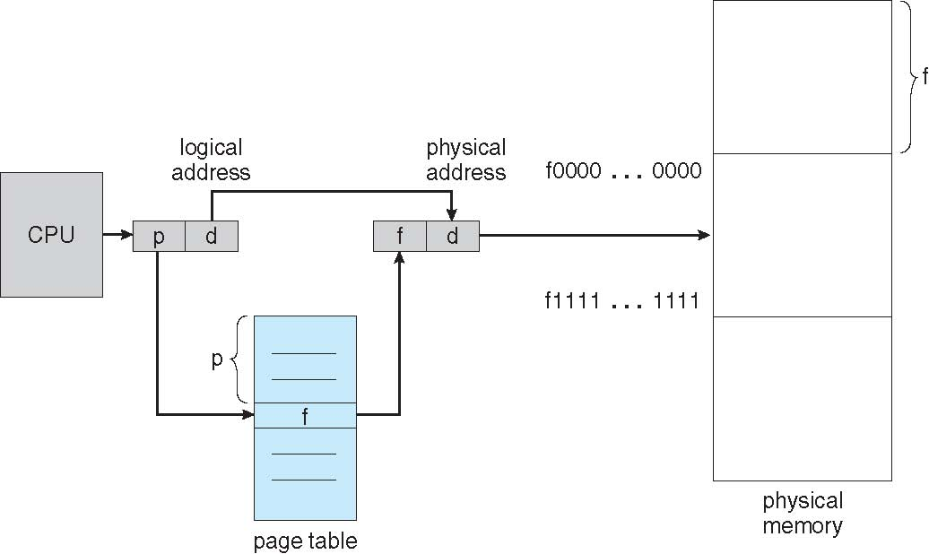
Page Address Translation

Slide 27
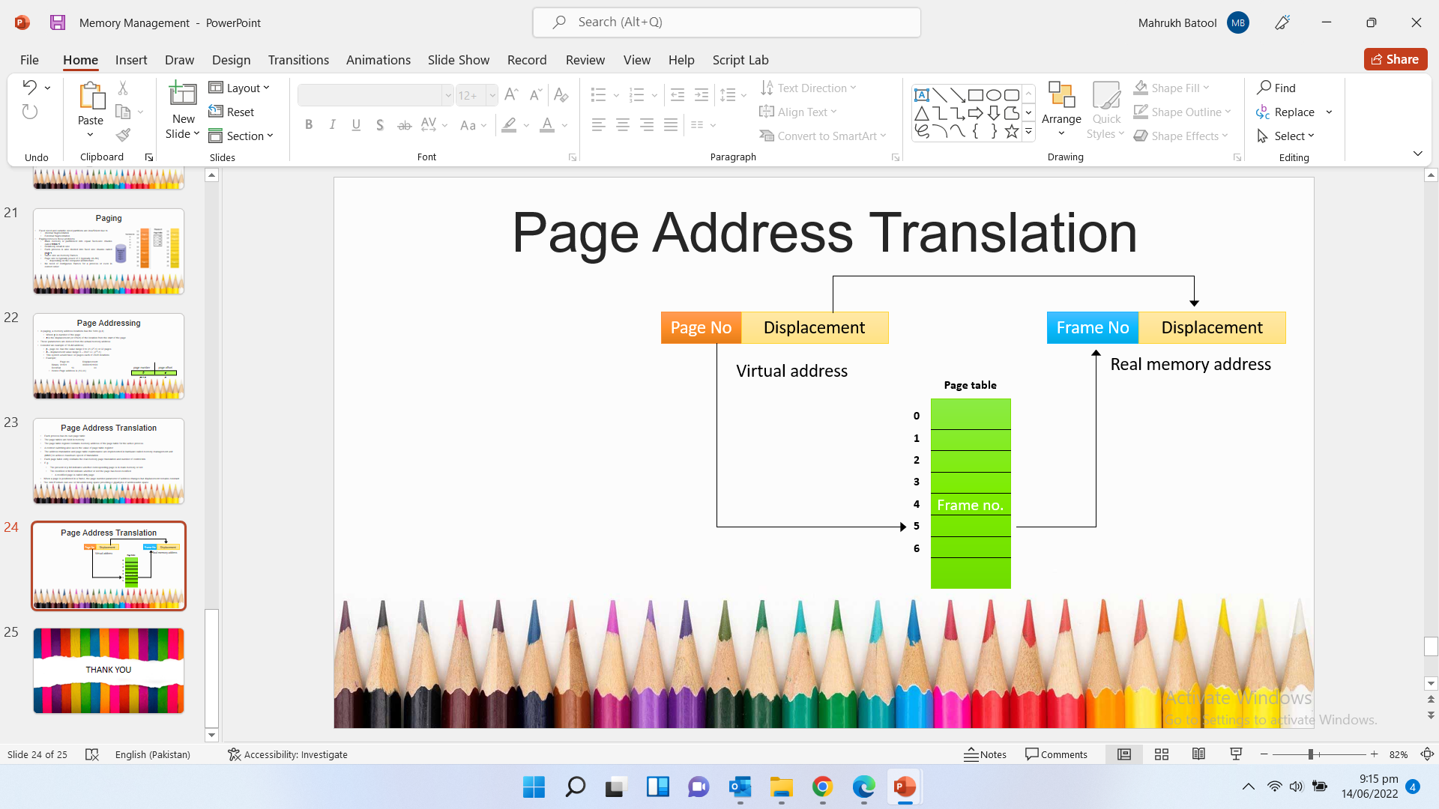
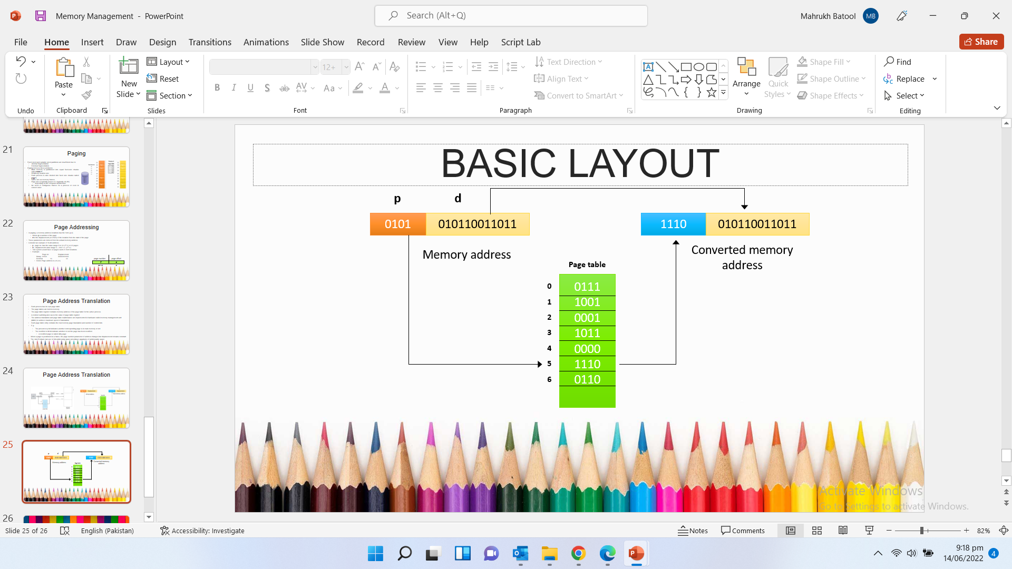
Page Address Translation

Slide 28
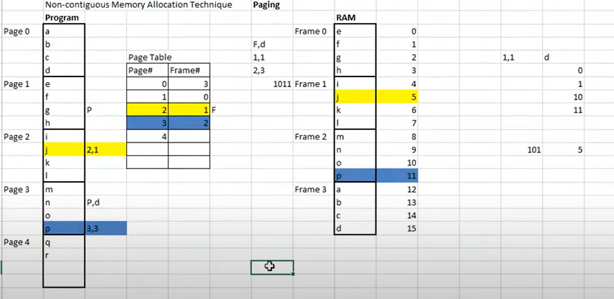
Page Address Translation

Slide 29
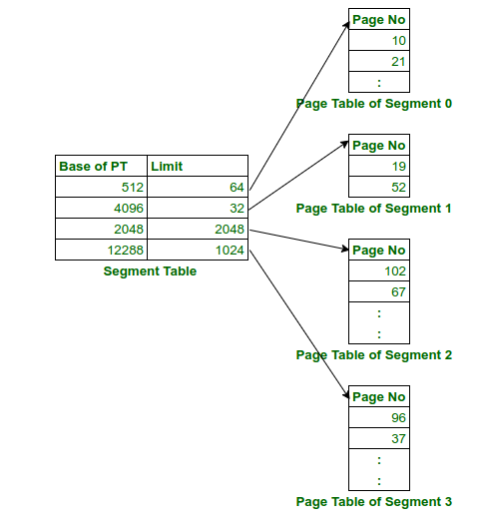
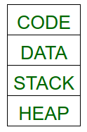
Paged Segmentation
The memory management unit (MMU) will use the segment table which will contain the address of page table(base) and limit. The page table will point to the page frames of the segments in main memory.
A solution to the problem is to use segmentation along with paging to reduce the size of page table. Traditionally, a program is divided into four segments, namely code segment, data segment, stack segment and heap segment.
The size of the page table can be reduced by creating a page table for each segment. To accomplish this hardware support is required. The address provided by CPU will now be partitioned into segment no., page no. and offset.

Slide 30
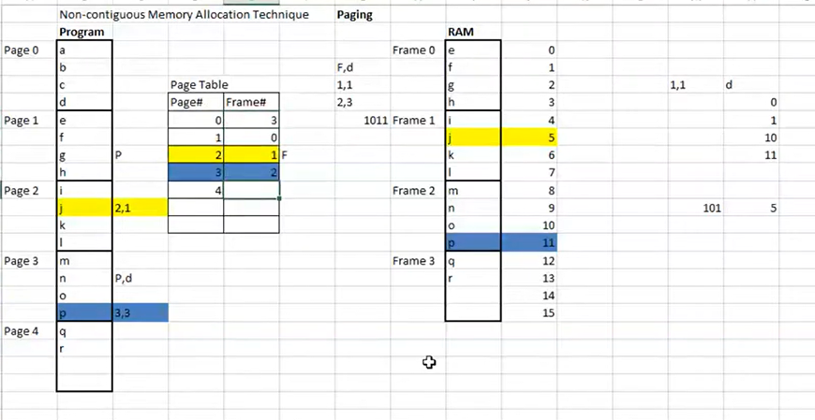
Internal Fragmentation
Memory is divided into a number of fixed partitions
Each partition may contain exactly one process
When partition is free another process is loaded into free partition
Waste considerable amount of main memory when processes are smaller than allocated partition
Called internal fragmentation
First employed in multiprogramming computers
Used in IBM OS/360
Disadvantages
Prevent a process being run due to unavailability of sufficient size partition
Internal fragmentation wastes space
Memory is allocated more than the requirements so this is called internal fragmentation

Slide 31
Protection
Memory protection implemented by associating protection bit with each frame to indicate if read-only or read-write access is allowed
Can also add more bits to indicate page execute-only, and so on
Valid-invalid bit attached to each entry in the page table:
“valid” indicates that the associated page is in the process’ logical address space, and is thus a legal page
“invalid” indicates that the page is not in the process’ logical address space
Or use page-table length register (PTLR)
Any violations result in a trap to the kernel
On checking valid bit: Trap for the page is not available or the page is not the part of program

Slide 32

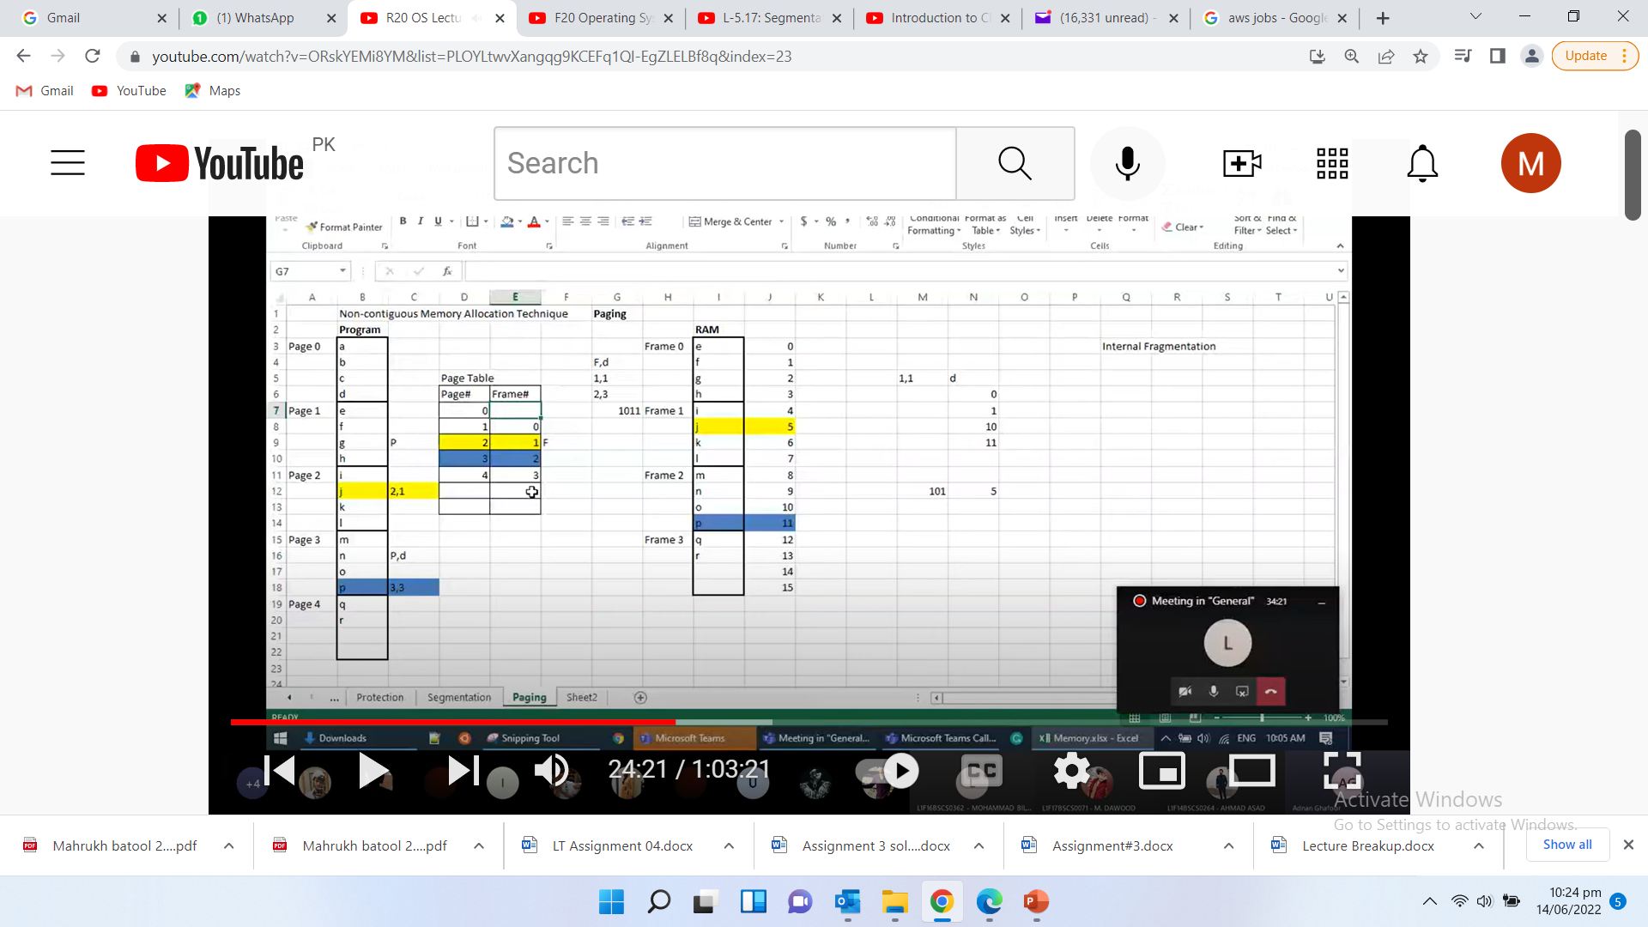
Protection
Page zero is not available in memory so deleted the reference of frame so valid bit is introduced for the each entry of page table
V bit
0
1
1
1

Slide 33
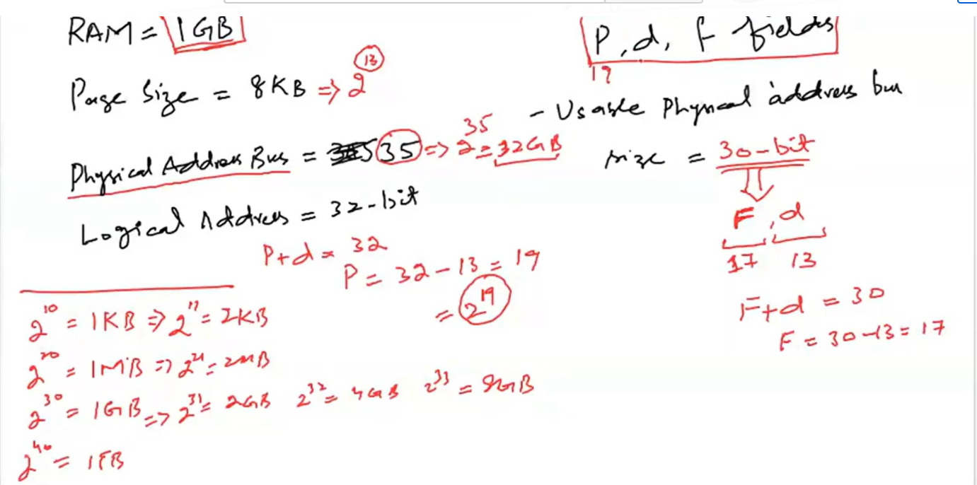
Bits calculation

Slide 34
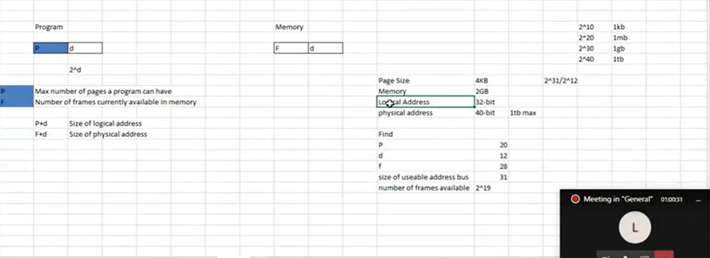
Bits calculation

Slide 35
Thank you

